Slide 1

Automata Theory Lecture: 5 How to Define Languages RE & DFA
Farhad Muhammad Riaz

Slide 2
Regular Expression
Equivalent Regular Expressions
Two regular expressions are said to be equivalent if they generate the same language
r1 = (a + b)* (aa + bb)
r2 = (a + b)*aa + ( a + b)*bb
the language of strings ending in aa or bb

Slide 3
Regular Expression
If r1 = (aa + bb) and r2 = ( a + b) then
r1+r2 = (aa + bb) + (a + b)
r1r2 = (aa + bb) (a + b)= (aaa + aab + bba + bbb)
(r1)* = (aa + bb)*

Slide 4
Regular Expression
Regular Languages
The language generated by any regular expression is called a regular language.

Slide 5
Regular Expression
If r1 = (aa+bb) and r2 = (a+b) then the language of strings generated by
r1+r2, is also a regular language,
expressed by (aa+bb) + (a+b)
If r1 = (aa+bb) and r2 = (a+b) then the language of strings generated by
r1r2, is also a regular language,
expressed by (aa+bb)(a+b)
If r = (aa+bb) then the language of strings generated
by r*, is also a regular language,
expressed by (aa+bb)*

Slide 6
Regular Expression
All finite languages are regular (an Important Concept)
Consider the language L, defined over ∑ = {a,b}, of strings of length 2, starting with a,
L = {aa, ab},
aa+ab

Slide 7
What is DFA
A finite automaton is a collection of three things:
A finite set of states, one of which is designated as the initial state, called the start state, and some (maybe none) of which are designated as final states.
An alphabet Σ of possible input letters.
A finite set of transitions that tell for each state and for each letter of the input alphabet which state to go next.

Slide 8
How Does a Finite Automaton work?
It works by being presented with an input string of letters that it reads letter by letter starting from the leftmost letter.
Beginning at the start state, the letters determine a sequence of states.
This sequence ends when the last input letter has been read
We will use the term FA for the phrase “finite automaton”.

Slide 9
Abstract definition of FA
A finite set of states Q = {q₀, q₁, q₂ q₃ …} of which q₀ is start state.
A subset of Q called final state (s).
An alphabet ∑ = { x₁, x₂, x₃, …}.
A transition function δ associating each pair of state and letter with a state:
δ(q,x_{j})

Slide 10
Example
∑ = {a,b}
States: x, y, z where x is an initial state and z is final state.
Transitions:
At state x reading a, go to state z
At state x reading b, go to state y
At state y reading a, b go to state y
At state z reading a, b go to state z

Slide 11
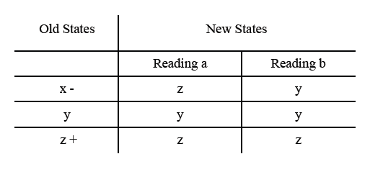
Example

Slide 12
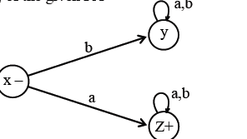
Example

Slide 13
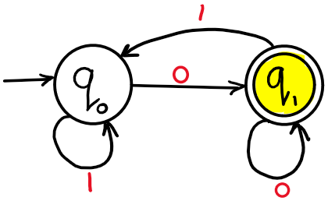
Example
Draw a DFA for the language accepting strings ending with ‘0’ over input alphabets ∑={0, 1}

Slide 14
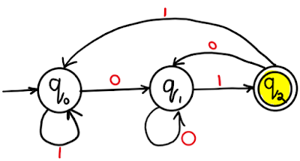
Example
Example 2: Draw a DFA for the language accepting strings ending with ‘01’ over input alphabets ∑={0, 1}

Slide 15
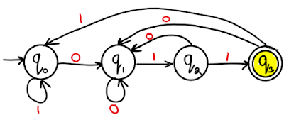
Example
Draw a DFA for the language accepting strings ending with ‘011’ over input alphabets ∑ = {0, 1}

Slide 16
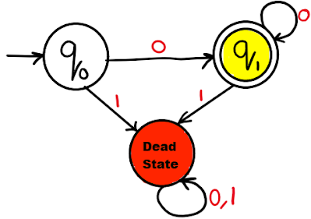
Example
Draw a DFA for the language accepting strings with ‘0’ only over input alphabets ∑={0, 1}

Slide 17
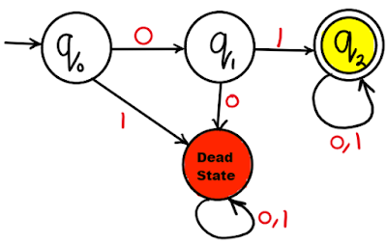
Example
Draw a DFA for the language accepting strings starting with ‘01’ over input alphabets ∑={0, 1}

Slide 18
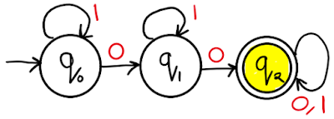
Example
Draw a DFA for the language accepting strings containing at least two ‘0’ over input alphabets ∑ = {0, 1} ?

Slide 19
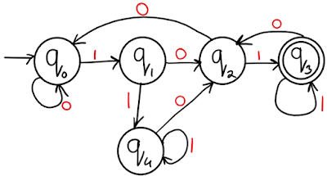
Example
Draw a DFA for the language accepting strings such that each ‘0’ is immediately preceded and followed by ‘1’ over input alphabets ∑ = {0, 1}
(0*10)*11*

Slide 20
Quiz (Your Turn)
Draw a DFA for the language accepting strings starting with ‘011’ over input alphabets ∑ = {0, 1}
Draw a DFA for the language accepting strings starting with ‘00’ or ’11’ over input alphabets ∑ = {0, 1}

Slide 21
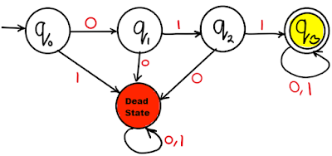
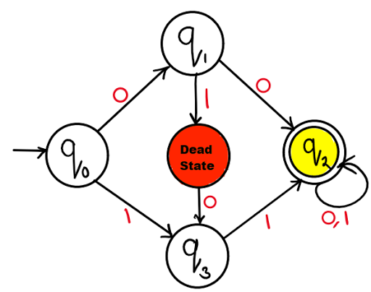
Solution

